Slide 1
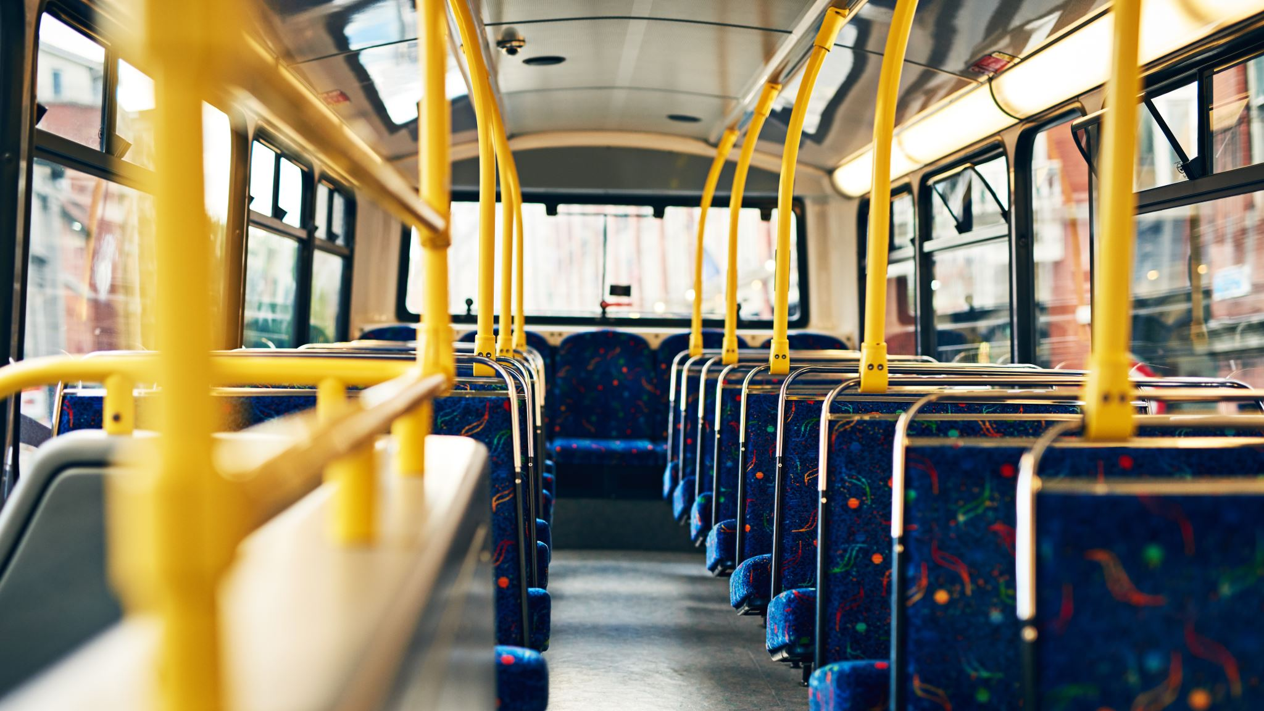
Bus Reservation System

Slide 2
Group - 10 Div – N Project Guide –Prof. Lokesh S. Khedekar
Members:
53- Harshwardhan Patil
54- Hemashri Patil
55- Himanshu Patil
56- Hiteshi patil
57- Indrajeet Patil
58- Kanaad Patil

Slide 3
Introduction to Bus Reservation System
Bus Reservation System Program is a comprehensive software solution designed to help bus operators manage their fleet and improve customer experience. It streamlines the booking process, allowing customers to book tickets, while also providing a wide range of features to help operators manage their fleet and increase efficiency.
The program is designed to be user-friendly and easy to use.
C programming language is one of the most popular languages used for creating such systems. It is a powerful, versatile language that is well-suited for developing applications with a wide range of features.

Slide 4
Features of Bus Reservation System
This system is based on a concept to reserve bus tickets. From this system, the user can view bus list, book tickets, cancel bookings and check bus status board.While booking tickets, the user has to enter bus number then the system displays total bus seat numbers with passengers name and the user has to enter the number of tickets, seat number, and name of the person. Here, cancel booking also features refunding. Login system is also available in this system to make it more secure. There’s no chance of data misuse or loss & it’s not time-consuming. The whole project is developed in ‘C’ Programming language, different variables and strings have been used for the development of this project. It’s easy to operate and understand by users.

Slide 5
Admin Module
The owner of the Simple Bus Reservation System application will have access to all parts of the system. Any changes in the backend will only be done by the admin. If the menus need to be changed or records modified, then the admin will be authorized to carry out such activities.

Slide 6
Reservation
This feature is very simple, it includes the bus no., seat number and the passenger’s name. The seat number of the particular bus is reserved under the passenger’s name.
Show Reservation Information
With this feature, you can show all the information regarding the buses and their respective seats. It contains all the information stored by the previous two function of this project. It also enlists the no. of empty seats in a bus along with the seat number registered to a particular passenger.
Buses Available
This feature simply shows the buses available for reservation, and the information regarding the bus no. stored under the first feature.

Slide 7
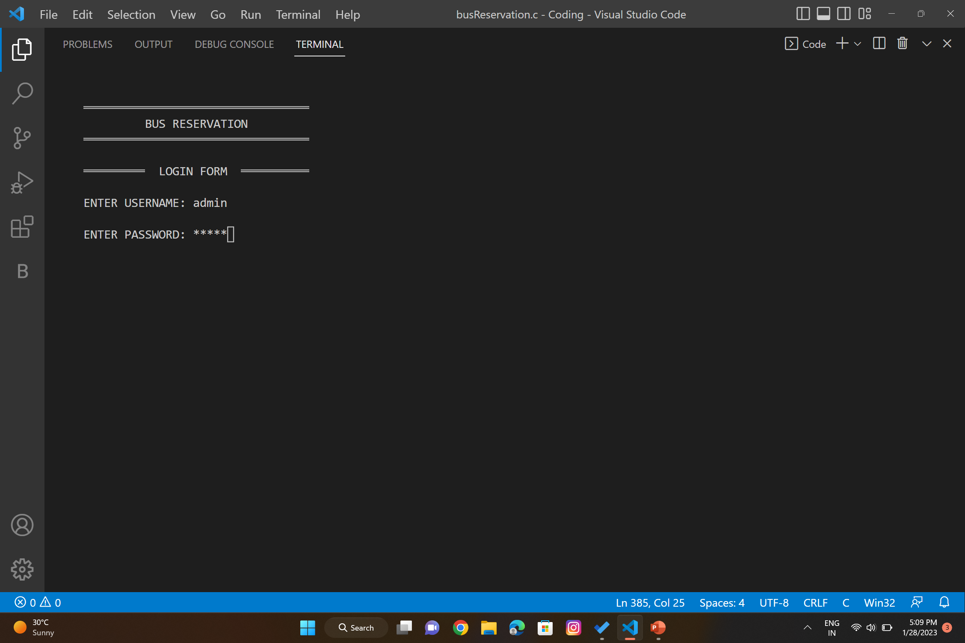
Project Login :

Slide 8
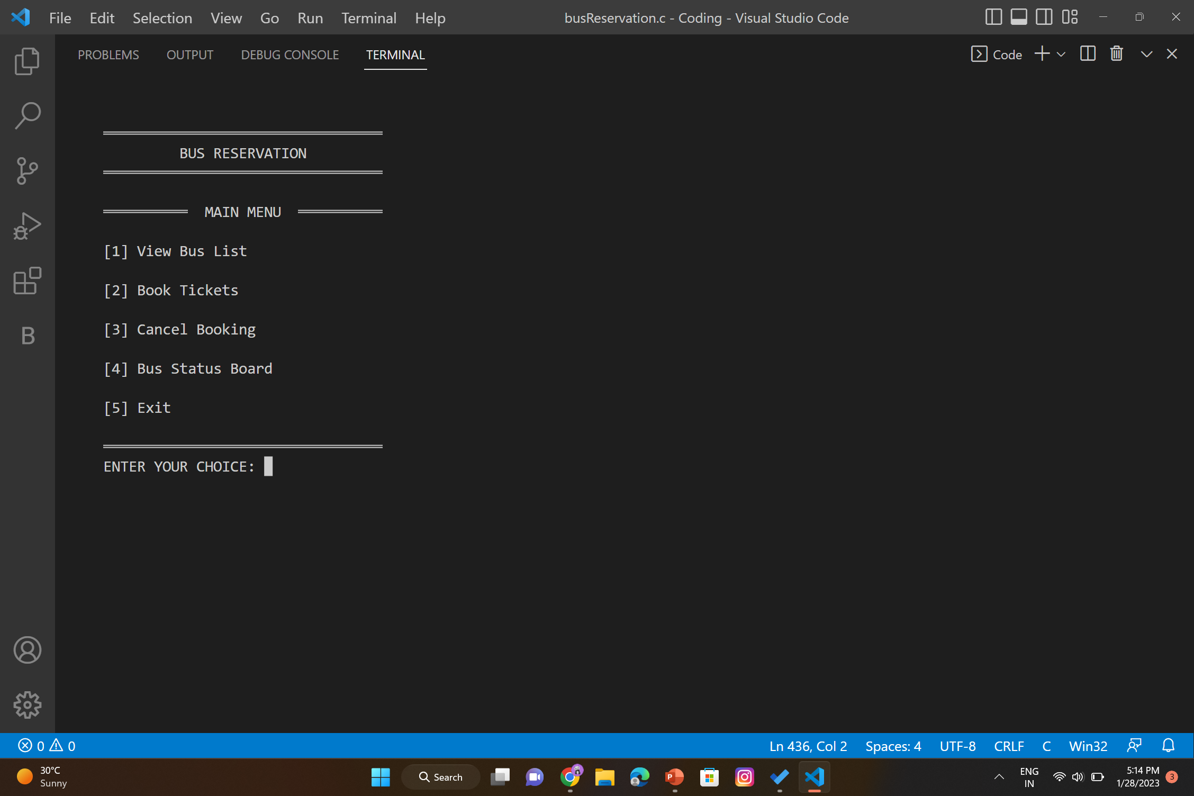
Options Available :

Slide 9
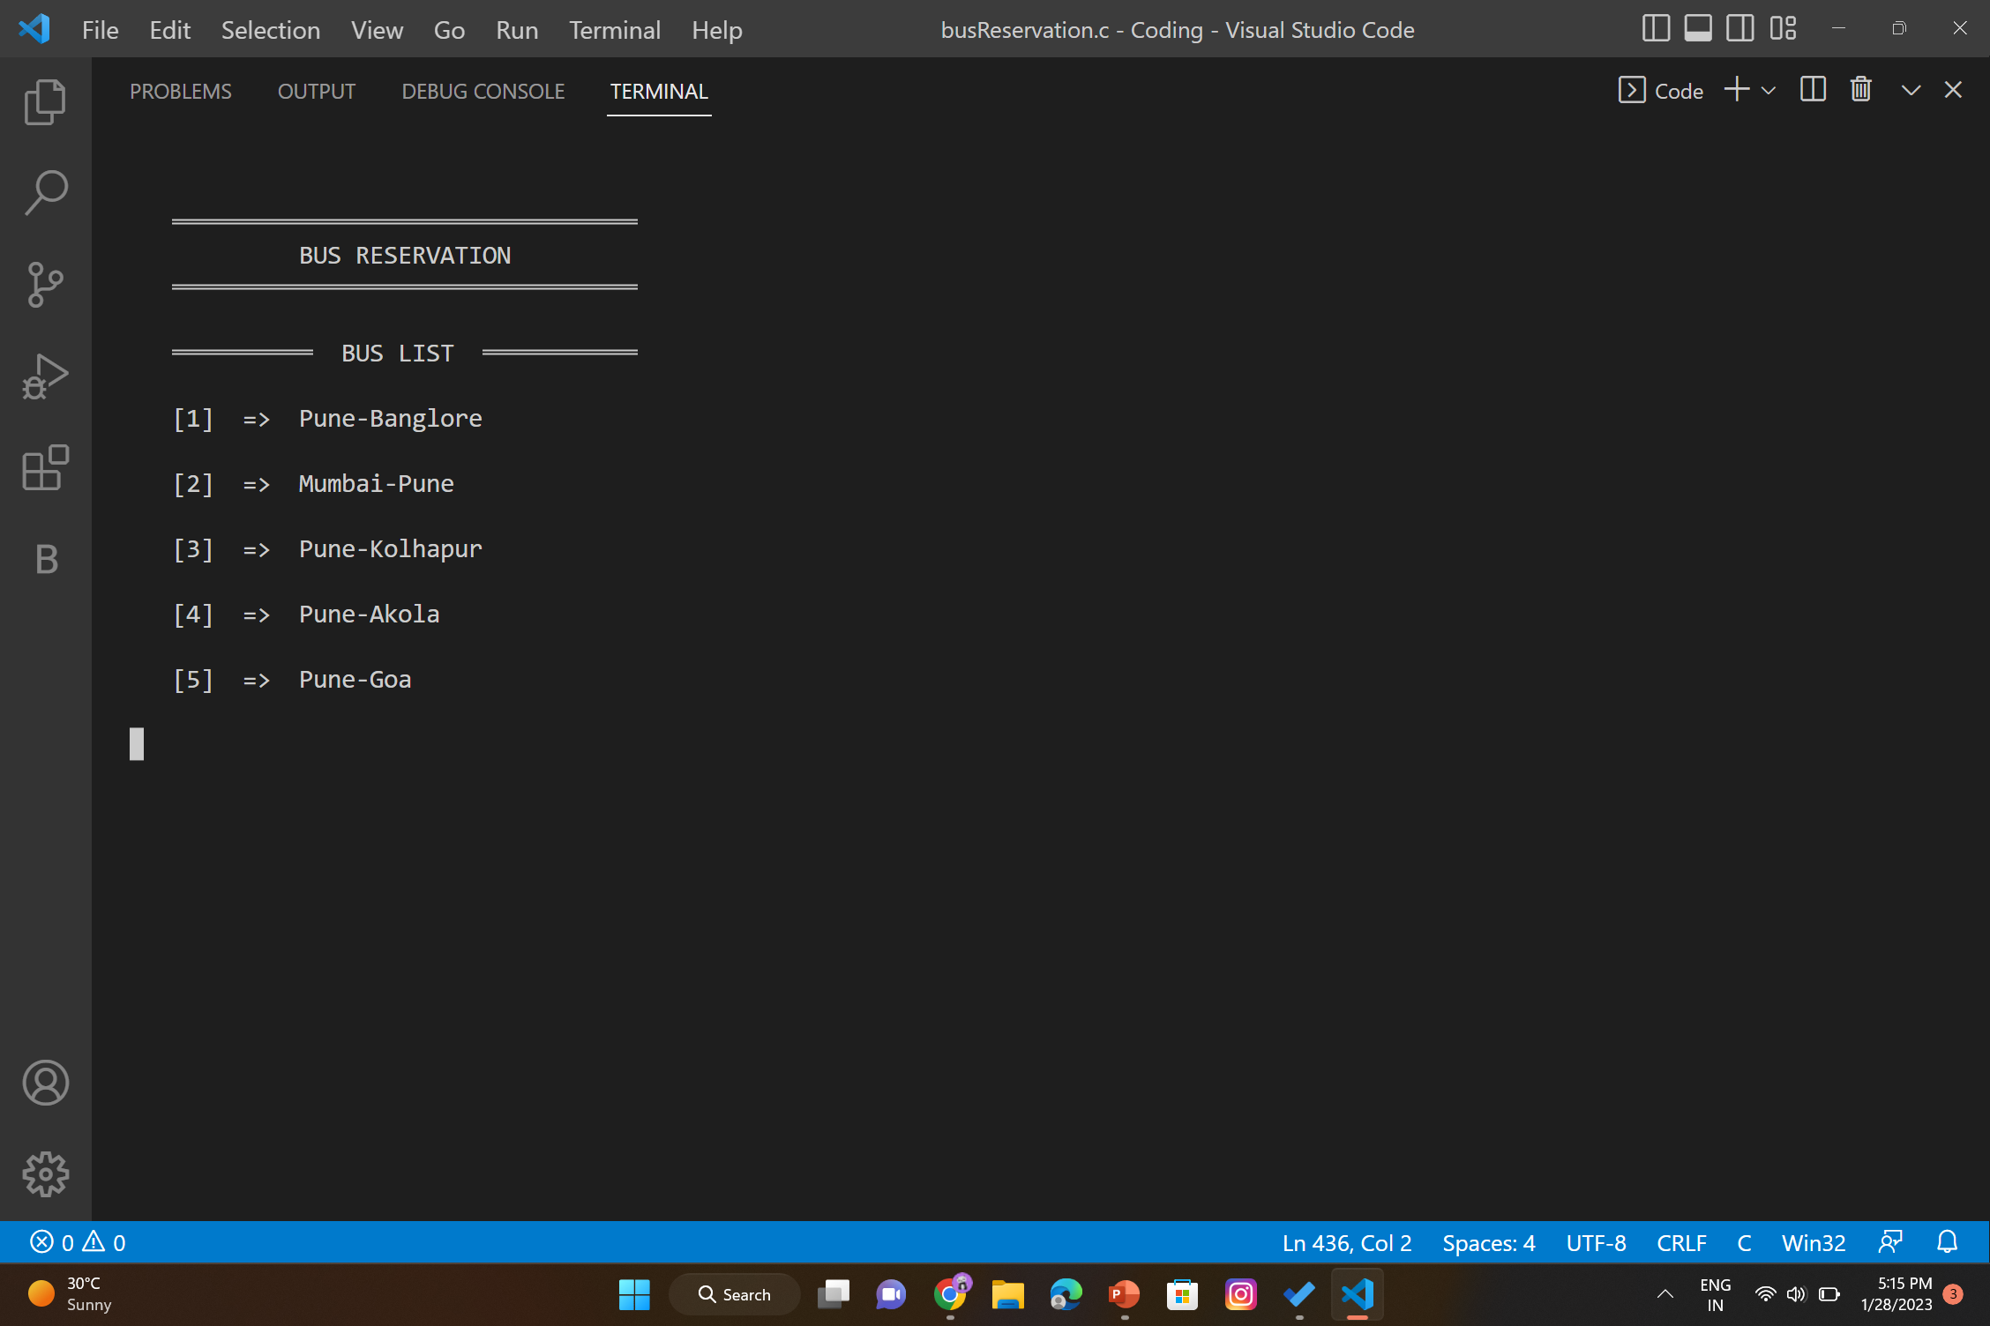
Bus List

Slide 10
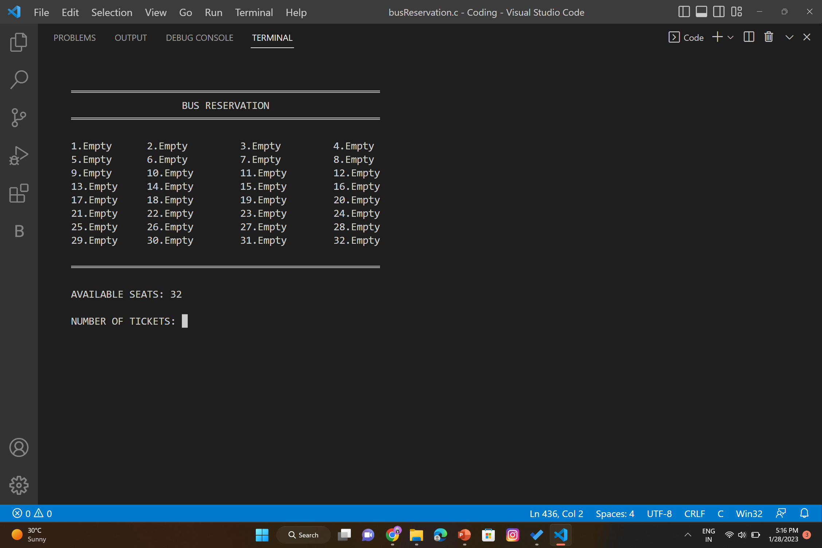
Available Seats:

Slide 11
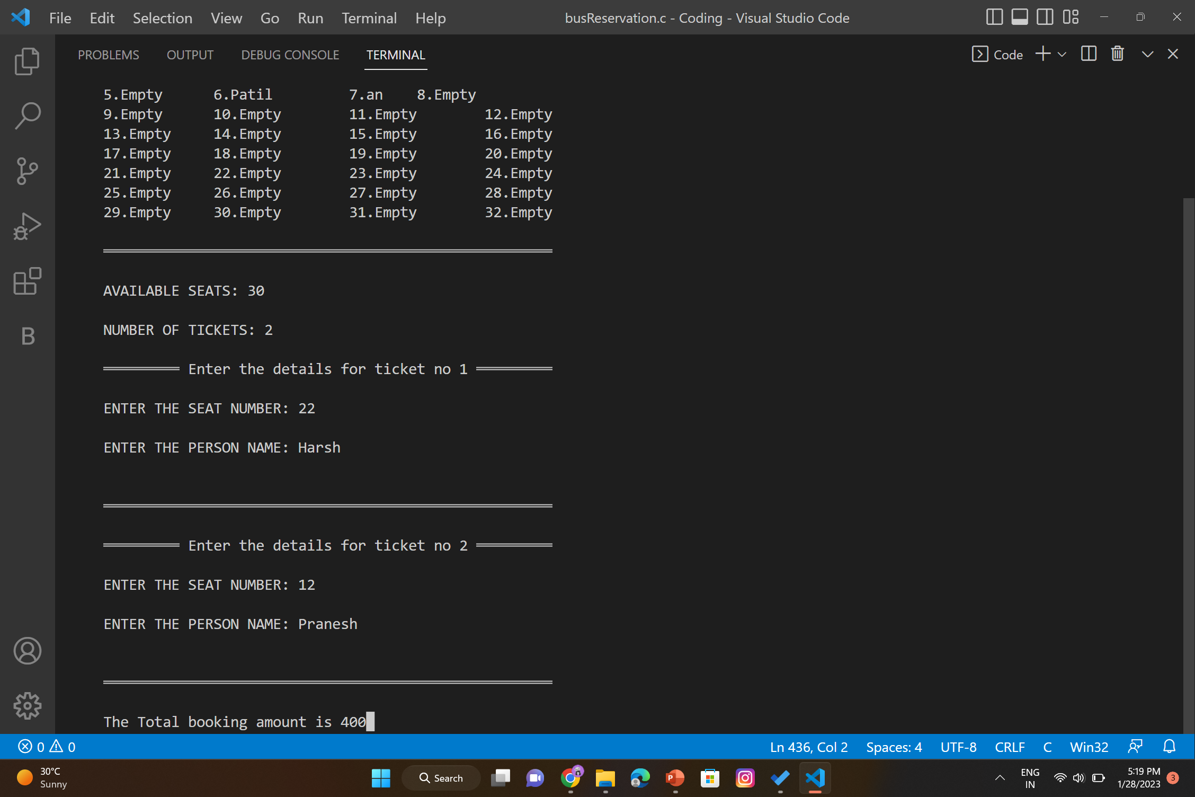
Booking seats :

Slide 12
Conclusion
In conclusion, C programming language is a powerful, versatile language that is well-suited for developing applications such as a bus reservation system. It provides a wide range of features that can be used to create a user interface, process user input, and store data in a database.
By following the steps outlined in this presentation, it is possible to create a bus reservation system using C programming language. This will enable organizations to manage their transportation needs efficiently and securely.

